Slide 1
Bresenham’s Line Algorithm
Let us assume that P(x_{k}, y_{k} ) is the currently plotted pixel. Q(x_{k+1}, y_{k+1} ) ↔(x_{k+1}, y ) is the next point along the actual path of line. We need to decide next pixel to be plotted from two candidate positions Q1(x_{k}+1, y_{k} ) or Q2(x_{k}+1, y_{k}+1)

Slide 2
Bresenham’s Line Algorithm
Given the equation of line
y = mx + b
Thus actual value of y at x = x_{k+1} is given by
y = mx_{k+1} + b
= m(x_{k} + 1) + b 1
Let d₁ = | QQ₁|= distance of y_{k} from actual value of y
= y – y_{k}
= m(x_{k} + 1) + b – y_{k} 2
d₂ = | QQ₂| = distance of actual value of y from y_{k} +1
= y_{k+1} – y
= (y_{k} + 1)– [m(x_{k} + 1) + b] 3

Slide 3
Bresenham’s Line Algorithm
The difference between these 2 separations is
d₁-d₂ = m(x_{k} + 1) + b – y_{k} –((y_{k} + 1)– [m(x_{k} + 1) + b]))
=m(xk+1)+b-yk-(y_{k}+1) +m(xk+1)+b
=2m(x_{k} + 1) + 2b –y_{k}– (y_{k}+ 1)
= 2m(x_{k} + 1) – 2 y_{k} + 2b – 1

Slide 4
Bresenham’s Line Algorithm
we can define a decision parameter p_{k} for the k^{th} step to by simplifying above equation such that the sign of P_{k} is the same as the sign of d₁-d₂, but involves only integer calculations.
Define P_{k} = Δx ( d₁-d₂)

Slide 5
Bresenham’s Line Algorithm
If p_{k}< 0
⇒ ( d₁-d₂) <0
⇒ distance d₁ is less than d₂
⇒ y_{k} is closer to line-path
Hence Q1(x_{k}+1, y_{k} ) is the better choice
else
Q2(x_{k}+1, y_{k}+1) is the better choice
Thus if the parameter p_{k} is negative lower pixel is plotted else upper pixel is plotted

Slide 6
Bresenham’s Line Algorithm
To put p_{k} in the iterative form, we derived that
Pk<0
Yk+1=yk
Pk>0
Yk=yk+1

Slide 7
Bresenham’s Line Algorithm
The first parameter p₀ is directly computed as:
p₀ = 2 Δy.x₀ - 2 Δx.y₀ + c
= 2 Δy.x₀ - 2 Δx.y₀ + 2 Δy + Δx (2b-1)
Since (x₀,y₀) satisfies the line equation , we also have
y₀ = Δy/ Δx * x₀ + b
b = y₀ - Δy/ Δx * x₀
Combining the above 2 equations , we will have
p₀ = 2Δy – Δx
The constants 2Δy, 2Δy – Δx and 2Δy-2Δx are calculated once.

Slide 8
Bresenham’s Line Algorithm
STEPS FOR BRESENHAM’S LINE DRAWING ALGORITHM (for |m| < 1.0)
Input the two line end-points (x₀, y₀) and (x₁, y₁)
Plot the point (x₀, y₀)
Compute Δx = x₁ - x₀ , Δy = y₁ - y₀
Initialize p₀ = 2Δy – Δx
At each x_{k} along the line, starting at k = 0, perform the following test.
If p_{k} < 0
the next point to plot is (x_{k}+1, y_{k})
p_{k} = p_{k} +2Δy
else
the next point to plot is (x_{k}+1, y_{k}+1)
p_{k} = p_{k} +2Δy – 2Δx
Repeat step 5 (Δx – 1) times
Plot the point (x₁, y₁)
Exit

Slide 9
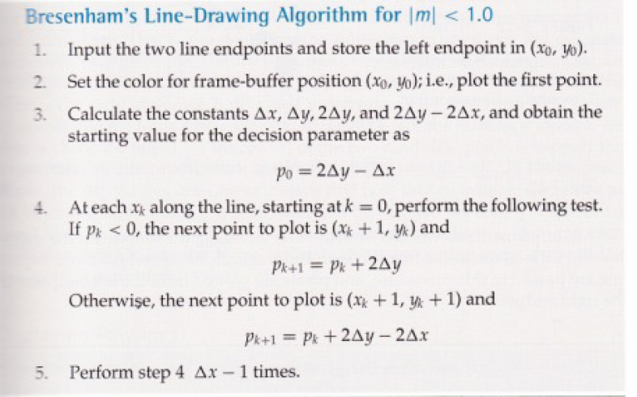

Slide 10
Bresenham’s Line Algorithm
4. General solution
The algorithm can be generalized for all slopes
Cases/ slope | Case I Δx>0 , Δy>0 | Case II Δx>0, Δy<0 | Case III Δx<0, Δy>0 | Case IV Δx<0, Δy<0
|m|<1 | p = 2dy-dx for x = x1 to x2 if p<0 p = p+ 2dy else { y=y+1 p = p+2(dy-dx)} | p = 2dy-dx for x = x1 to x2 if p<0 p = p+ 2dy else { y=y-1 p = p+2(dy-dx)} | swap points Case II | swap points Case I
|m|>1 | p = 2dx-dy for y= y1 to y2 if p<0 p = p+ 2dx else { x=x+1 p = p+2(dx-dy)} | p = 2dx-dy for y= y2 to y1 if p<0 p = p+ 2dx else { x=x+1 p = p+2(dx-dy)} | swap points Case II | swap points Case I

Slide 11
Bresenham’s Line Algorithm
5. Exercise
Calculate pixel positions that made up the line connecting endpoints: (12, 10) and (17, 14).
1. (x₀, y₀) = ?
2. Δx = ?, Δy =?, 2Δy = ?, 2Δy – 2Δx =?
3. p₀ = 2Δy – Δx =?
k | p_{k} | (x_{k+1}, y_{k+1})

Slide 12
Bresenham’s Line Algorithm
5. Exercise
Calculate pixel positions that made up the line connecting endpoints: (12, 10) and (17, 14).
1. (x₀, y₀) = (12,10)
2. Δx = 5, Δy =4, 2Δy = 8, 2Δy – 2Δx =-2
3. p₀ = 2Δy – Δx =3
k | p_{k} | (x_{k+1}, y_{k+1})
0 | 3
1
2

Slide 13
Bresenham’s Line Algorithm
5. Exercise
Calculate pixel positions that made up the line connecting endpoints: (12, 10) and (17, 14).
1. (x₀, y₀) = (12,10)
2. Δx = 5, Δy =4, 2Δy = 8, 2Δy – 2Δx =-2
3. p₀ = 2Δy – Δx =3
k | p_{k} | (x_{k+1}, y_{k+1})
0 | 3 | (13, 11)
1 | 1 | (14, 12)
2 | -1 | (15, 12)
3 | 7 | (16, 13)
4 | 5 | (17, 14)

Slide 14
Bresenham’s Line Algorithm
5. Exercise: Trace for (20,10) to (30,18)
k | p_{k} | (x_{k+1},y_{k+1})
18
17
16
15
14
13
12
11
10
20
21
22
23
24
25
26
27
28
29
30

